Slide 1
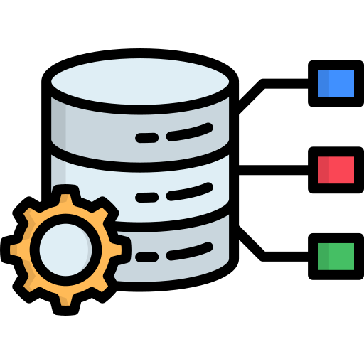
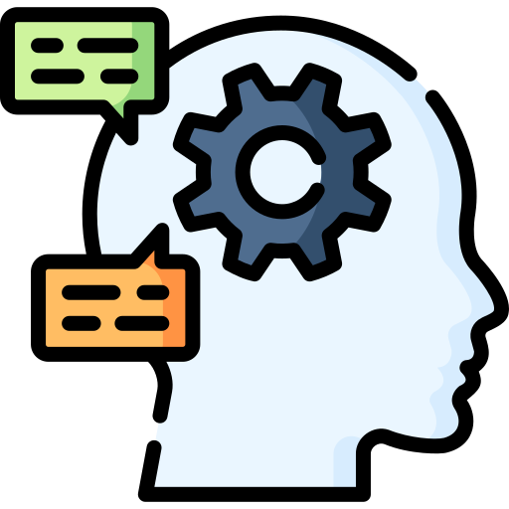


OBJECTIVE
Conversational AI Agent for Smart IoT Control
DOMAIN: AI & IOT

Slide 2
OBJECTIVE
Natural Language Control
Multi-Channel Query Resolution
Predictive Maintenance & Diagnostics
(Optional)
Build a chat-based AI assistant that can control and monitor IoT devices using simple, human-like commands.
Enable Real-Time support across platforms (WhatsApp/Telegram/Slack)
To fetch device data, logs, and health status through chat
Integrate intelligent diagnostics to analyze past logs and predict potential device failures before they happen.

Slide 3
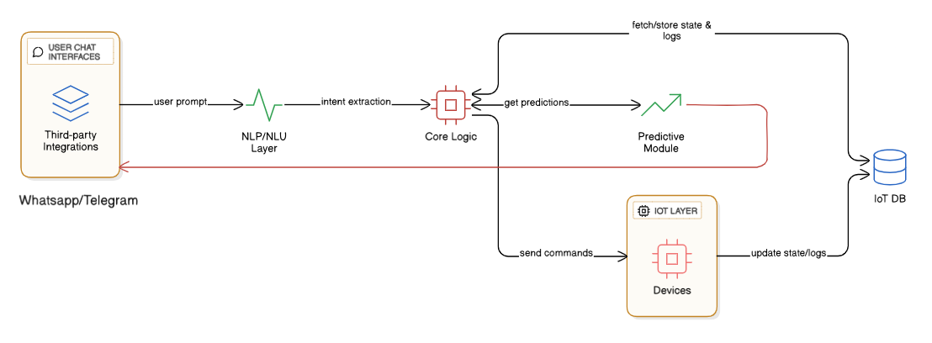
OBJECTIVE
IMPLEMENTATION

Slide 4
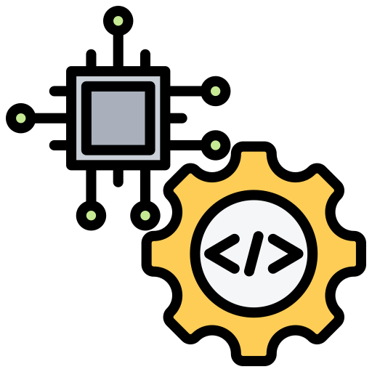

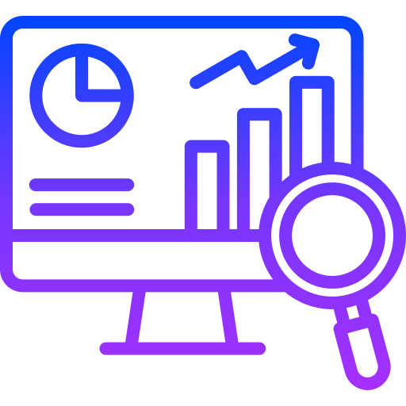
OUTCOMES
A plug-and-play AI agent that works on platforms like WhatsApp, Slack, and Telegram, allowing users to:
Control devices using natural commands like: "Turn off the greenhouse fan if humidity > 70%"
Ask real-time queries such as: "Why did the pump fail yesterday?"
Receive smart predictions like: "Compressor in Unit 3 may fail in 14 days"

Slide 5

TECH STACK
AI/NLP
Backend & Logic
IoT Communication
OpenAI GPT-4:
for understanding prompts
Rasa or Dialogflow:
for intent classification,
fallback handling
Python:
For Core logic, API integration
FastAPI or Flask:
For REST API services
MQTT / HTTP:
For Device communication protocols
Node-RED:
Optional for visual IoT flows
Database
Platforms & Deployment
Predictive Analytics (Optional)
Firebase / MongoDB:
Device states, logs, user queries
Twilio: WhatsApp integration
Slack API / Telegram Bot API
Scikit-learn / TensorFlow:
for failure prediction models

Slide 6
THANK YOU
SHAIKH SAAIEM SALAAR MOHAMMED SALEEM RAISA
NEVREKAR MOHAMMED ANAS AZIM AMREEN
SAYED MOHAMMED KUMAYL MOHAMMED SUHAIL

